Slide 1
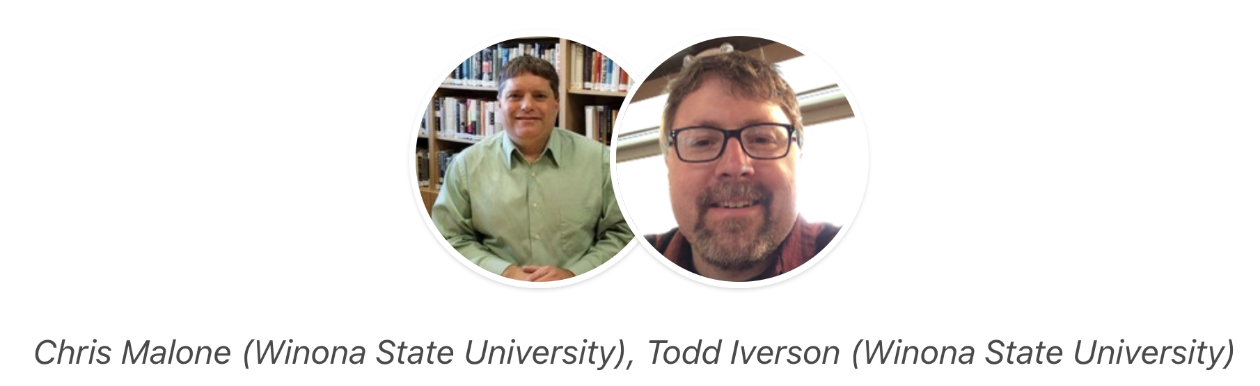

Less is more: Writing code in an introductory data science course
Slides and more
Winona State University
Winona, MN. USA
GitHub repo: https://shorturl.at/5Nodo

Slide 2
Workshop Outline
Session 1
Session 2
Overview of DSCI 210
Technology agnostic exercises
Low code data management
Translate to code
Technology agnostic introduction to combining and reshaping tables
Low code implementation
Session 3
Guided activities

Slide 3
The Core Data Science Curriculum
Data Management
Visualization
Statistical Learning
DSCI 210
Survey
DSCI 210
Survey
DSCI 210
Survey
STAT 210/310
Intro Stats
DSCI 325
Structured
DSCI 326
DS @ Scale
DSCI 330
Unstructured
DSCI 310
Intro to Viz
STAT 360
Regression
DSCI 415
Unsupervised
Learning
DSCI 425
Supervised
Learning

Slide 4
The Introductory Course
Data Management
Visualization
Statistical Learning
DSCI 210
Survey
DSCI 210
Survey
DSCI 210
Survey
STAT 210/310
Intro Stats
DSCI 325
Structured
DSCI 326
DS @ Scale
DSCI 330
Unstructured
DSCI 310
Intro to Viz
STAT 360
Regression
DSCI 415
Unsupervised
Learning
DSCI 425
Supervised
Learning

Slide 5
Outline for DSCI 210
Intro to Tidy Data
Aggregation
Data Verbs
Intro to Visualization
Classification Trees
Managing Textual Data
Intro to R/tidyverse
Reshaping Tables
Combining Tables
Intro. to Association Rules

Slide 6
Key Insights and Lessons Learned
The 80% Rule.
The Payoff.
Technology Agnostic.
Low Code.
Translate to Code.

Slide 7
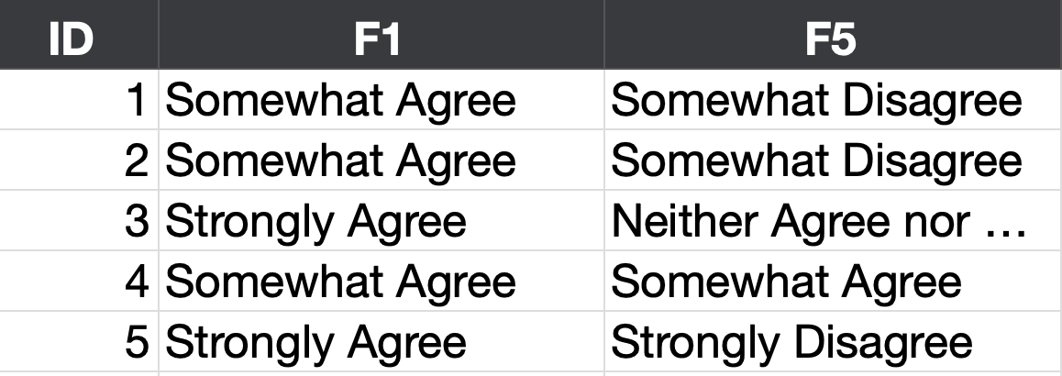
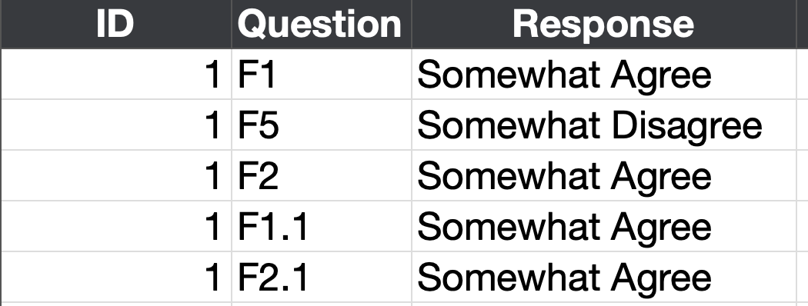
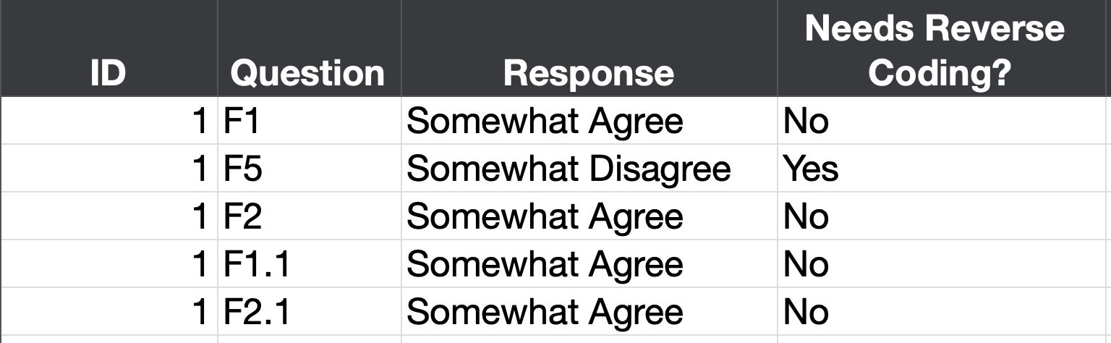
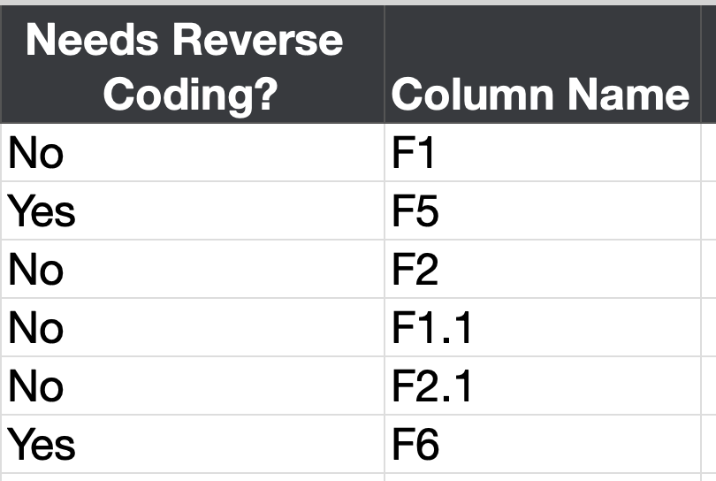
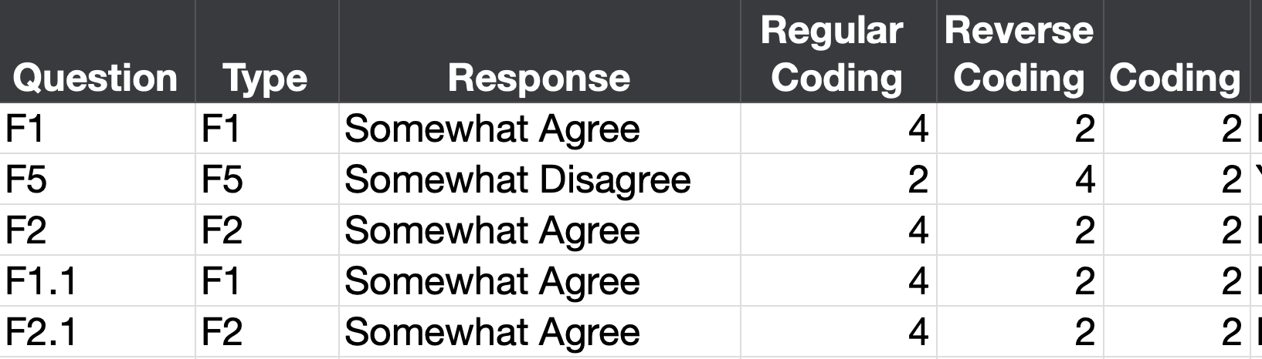
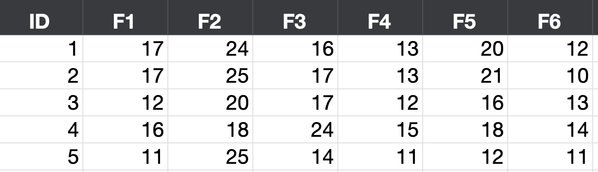
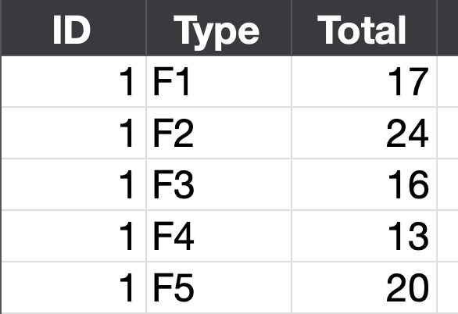
Response Table
Stacked Response Table
Joined Table
Reshape
Join
Agree?
Disagree?
Transform
Question Table
Unstack
Aggregate

Slide 8
Response Table
Stacked Response Table
Joined Table
Reshape
Join
Agree?
Disagree?
Transform
Question Table
What did we learn?
The Payoff
Unstack
Aggregate

Slide 9
Technology Agnostic
Teach concepts before specific technology

Slide 10
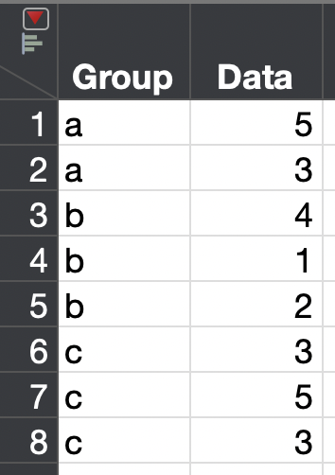
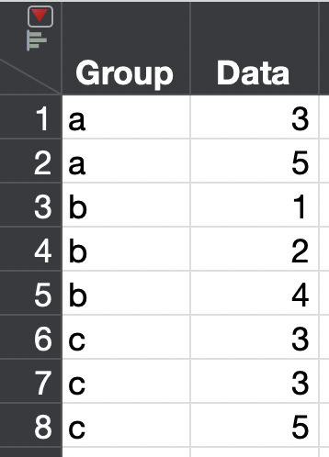
Technology Agnostic Data Verbs
D | G
5 | a
3 | a
4 | b
2 | b
3 | c
5 | c
4 | c
D
5
3
4
2
3
5
4
D | G
5 | a
3 | a
4 | b
2 | b
3 | c
5 | c
4 | c
D | G
5 | a
3 | a
4 | b
2 | b
3 | c
5 | c
4 | c
D | G | N
5 | a | 10
3 | a | 6
4 | b | 8
2 | b | 4
3 | c | 6
5 | c | 10
4 | c | 8
D | G
4 | b
2 | b
3 | c
5 | c
4 | c
Select (D)
Mutate (N = 2*D)
Filter (G is not a)
D | G
5 | a
3 | a
4 | b
2 | b
3 | c
5 | c
4 | c
G | Mean(D)
a | 4
b | 3
c | 4
PARTITION BY
Group
ORDER BY
Data ASC
GROUPBY (G)
AGG
MEAN(D)

Slide 11
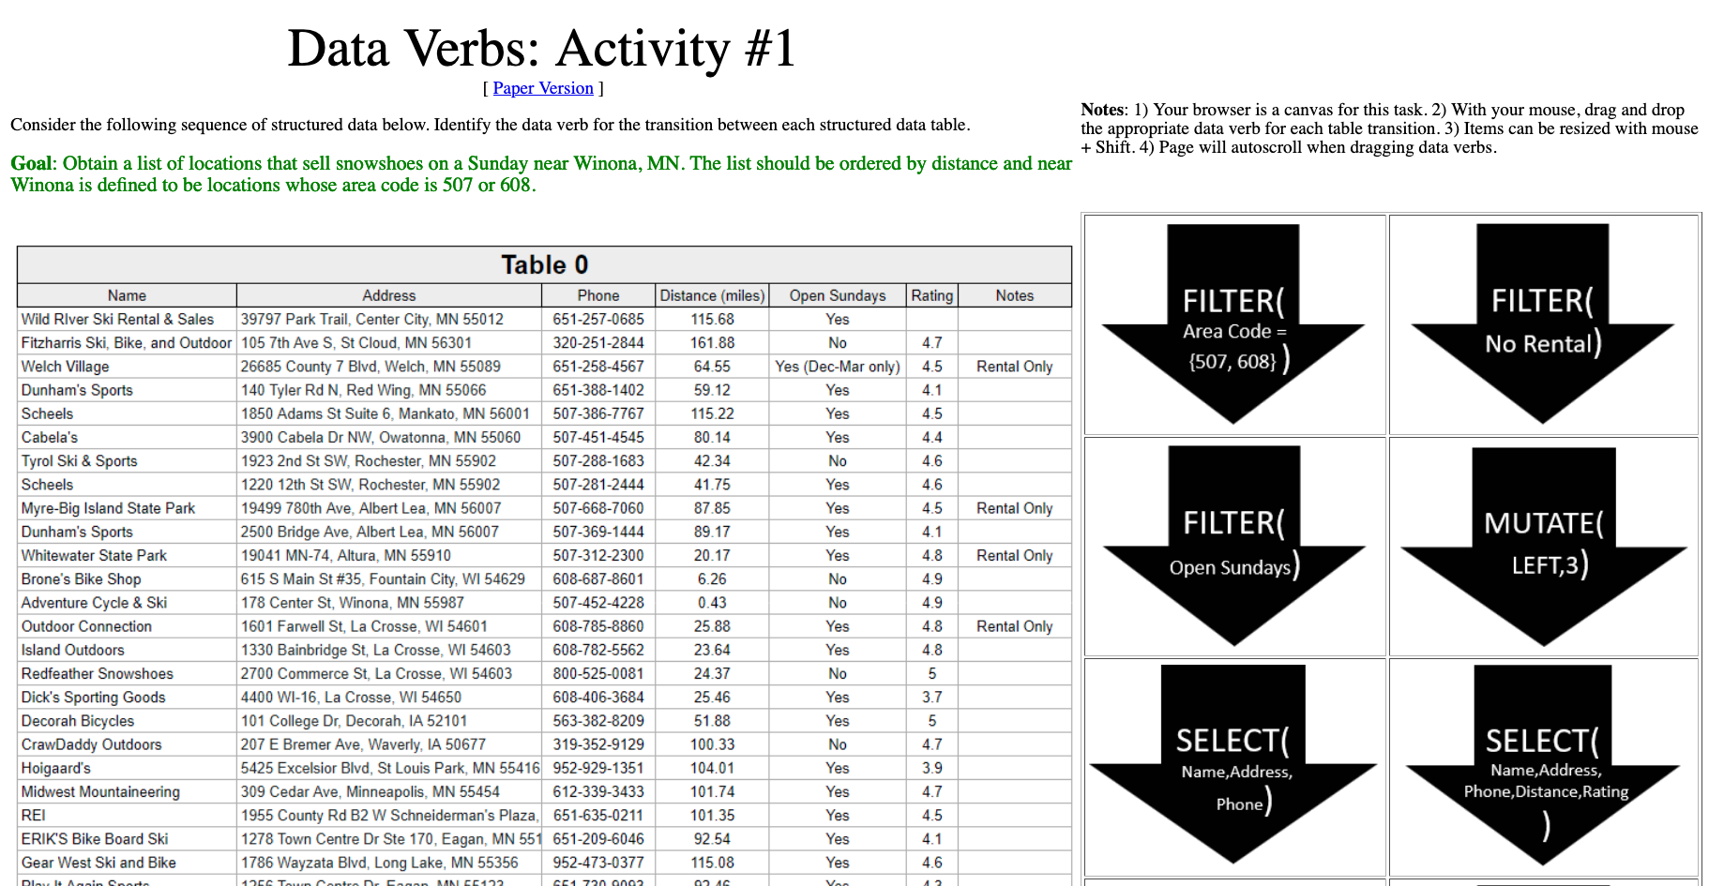

Example 1 Purchasing Snowshoes
http://statsclass.org/dsci210/Dataverbs/

Slide 12
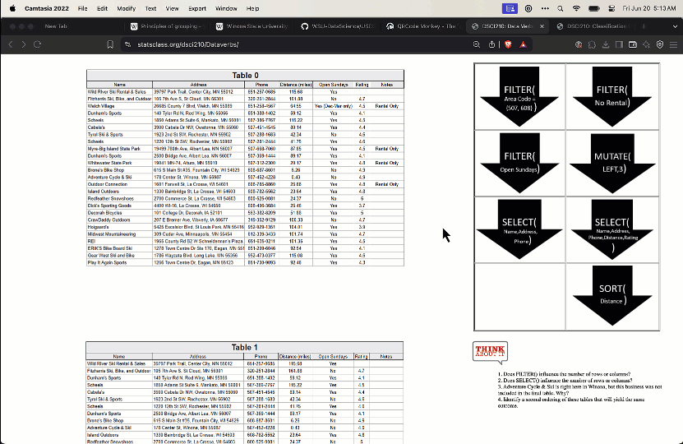
Interactive Activity on Data Verbs

Slide 13
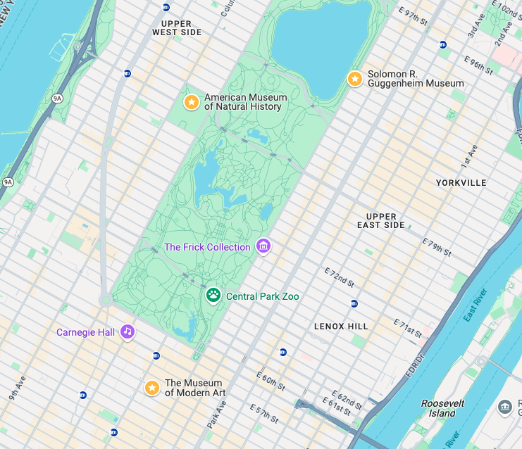

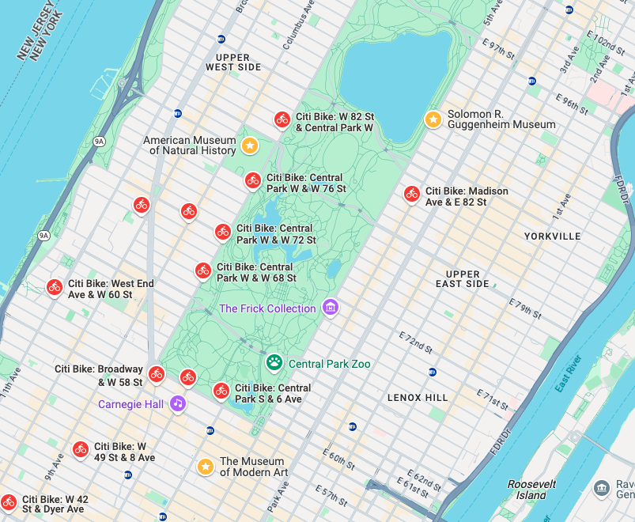
Problem 1 Two Museum Bike Tour
Start
End
Cheater!

Slide 14
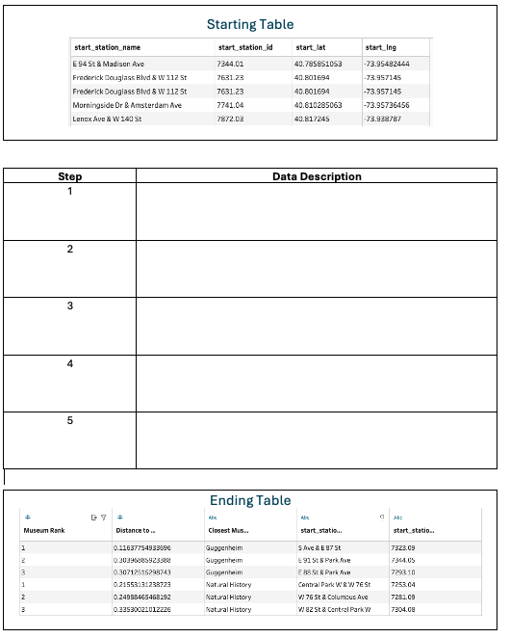
Exercise 1 Write out the steps (handout 1)
City Bike trip data
(one row per trip)
Instructions
Identify a sequence of data verbs to transform the Starting Table into the Ending Table
Use data verbs + some pseudo code
Example: MUTATE(ROUND(Distance))
Data Verbs
SELECT
FILTER
MUTATE
GROUPBY + AGGREGATE
PARTITIONBY + ORDERBY

Slide 15
Technology Agnostic Data Verbs
D | G
5 | a
3 | a
4 | b
2 | b
3 | c
5 | c
4 | c
D
5
3
4
2
3
5
4
D | G
5 | a
3 | a
4 | b
2 | b
3 | c
5 | c
4 | c
D | G
5 | a
3 | a
4 | b
2 | b
3 | c
5 | c
4 | c
D | G | N
5 | a | 10
3 | a | 6
4 | b | 8
2 | b | 4
3 | c | 6
5 | c | 10
4 | c | 8
D | G
4 | b
2 | b
3 | c
5 | c
4 | c
Select (D)
Mutate (N = 2*D)
Filter (G is not a)
D | G
5 | a
3 | a
4 | b
2 | b
3 | c
5 | c
4 | c
G | Mean(D)
a | 4
b | 3
c | 4
PARTITION BY
Group
ORDER BY
Data ASC
GROUPBY (G)
AGG
MEAN(D)

Slide 16
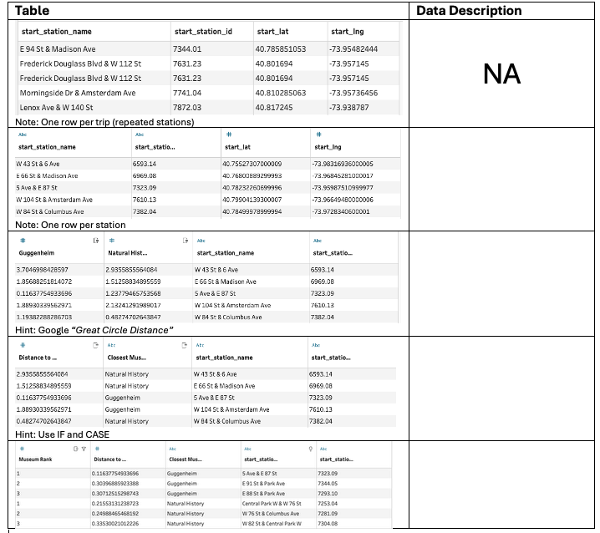
Exercise 2 Write out the steps (handout 2)
Instructions
Identify a sequence of data verbs to transform the Starting Table into the Ending Table
Use data verbs + some pseudo code
Example: MUTATE(ROUND(Distance))
Data Verbs
SELECT
FILTER
MUTATE
GROUPBY + AGGREGATE
PARTITIONBY + ORDERBY

Slide 17
Technology Agnostic Data Verbs
D | G
5 | a
3 | a
4 | b
2 | b
3 | c
5 | c
4 | c
D
5
3
4
2
3
5
4
D | G
5 | a
3 | a
4 | b
2 | b
3 | c
5 | c
4 | c
D | G
5 | a
3 | a
4 | b
2 | b
3 | c
5 | c
4 | c
D | G | N
5 | a | 10
3 | a | 6
4 | b | 8
2 | b | 4
3 | c | 6
5 | c | 10
4 | c | 8
D | G
4 | b
2 | b
3 | c
5 | c
4 | c
Select (D)
Mutate (N = 2*D)
Filter (G is not a)
D | G
5 | a
3 | a
4 | b
2 | b
3 | c
5 | c
4 | c
G | Mean(D)
a | 4
b | 3
c | 4
PARTITION BY
Group
ORDER BY
Data ASC
GROUPBY (G)
AGG
MEAN(D)

Slide 18
Low Code
Start with technology that minimizes the need for code

Slide 19
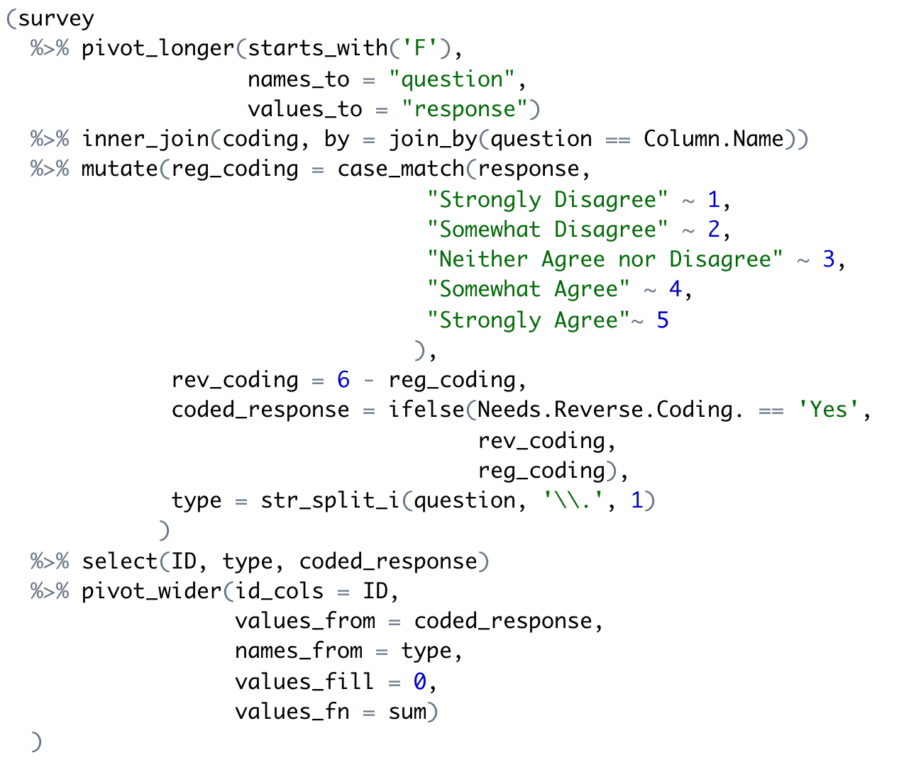
Learning to program is hard!
What should I do first? Second?
What functions should I use?
How do I make my code run/correct?

Slide 20
Doug is struggling!
Algorithm
Step-by-step process
What should I do first? Second?
What functions should I use?
How do I make my code run/correct?

Slide 21
Doug is struggling!
Algorithm
Step-by-step process
What should I do first? Second?
Implementation
Which libraries/functions
What functions should I use?
How do I make my code run/correct?

Slide 22
Doug is struggling!
Algorithm
Step-by-step process
What should I do first? Second?
Implementation
Which libraries/functions
What functions should I use?
Correct Code
Avoid bugs and verify correct results
How do I make my code run/correct?

Slide 23
We decouple the algorithm and the code!
Notes:
Then just in the nick of time …

Slide 24
The algorithm is most important Let’s make sure Doug is proficient here first!
Algorithm
Step-by-step process
Start here!
What should I do first? Second?
Implementation
Which libraries/functions
What functions should I use?
Correct Code
Avoid bugs and verify correct results
How do I make my code run/correct?

Slide 25
Coding should come later in the first course
Outline for DSCI 210
Low Code
Scripting + Low Code
Intro to Tidy Data
Aggregation
Data Verbs
Intro to Visualization
Classification and CART
String Verbs and Window Functions
Managing data with R/tidyverse
Reshaping tables
Table joins
Intro to Arules

Slide 26
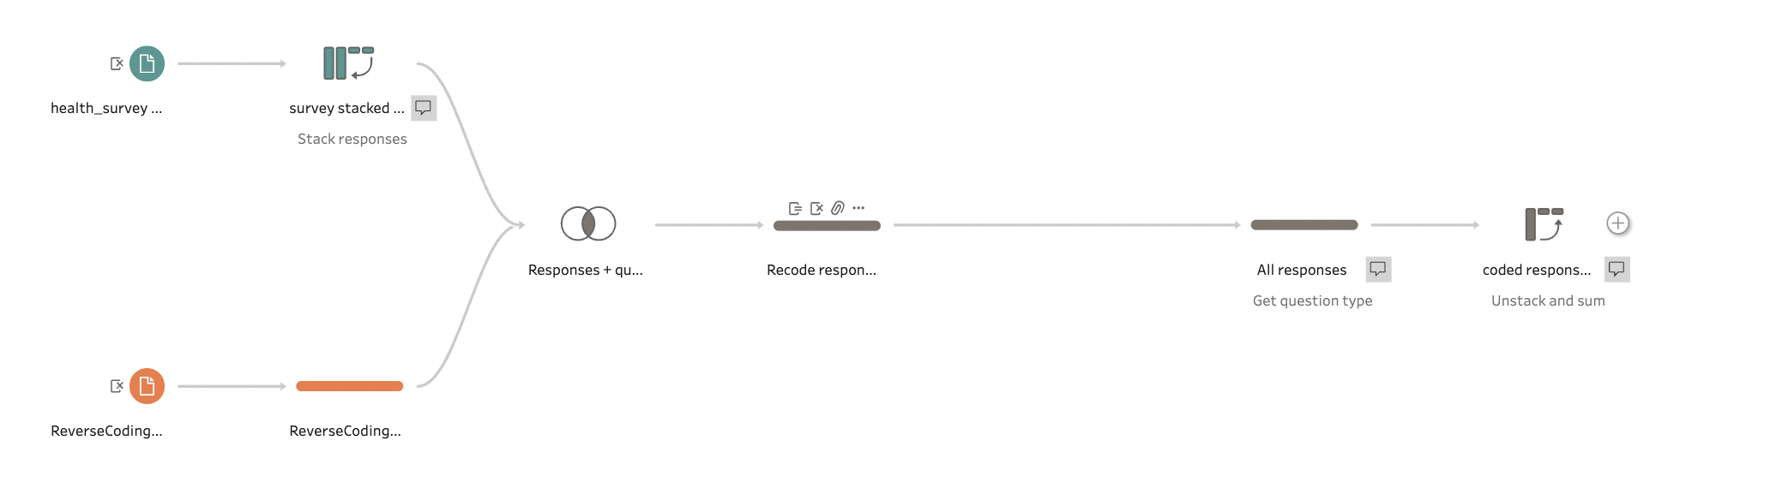
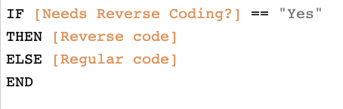
Low Code Data management with Tableau Prep
Only Code

Slide 27
The Tableau Prep visual interface
Load Data
Stack columns
Pivot
Unstack & Aggregate
Join
Transform
Transform
Load Data

Slide 28
Highlights to Exercise 3
Here are some of the things you will see in the walk through

Slide 29
Problem 1 Two Museum Bike Tour
Start
End
Task. Find the City Bike station closest to each museum

Slide 30
Minor Adjustment The data were filtered to make the download manageable
First week of June 2025
Starting near Central Park

Slide 31
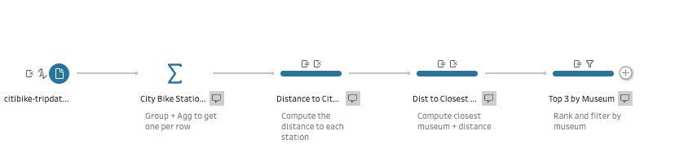
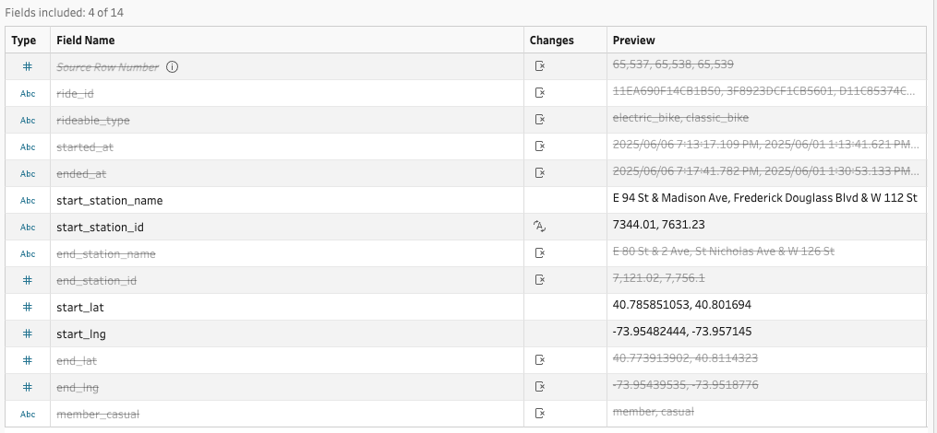
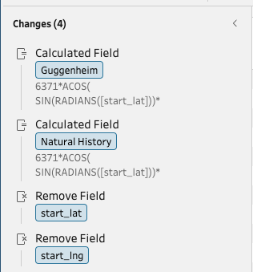
SELECT Two examples of mutates
Initial select
Dropping columns

Slide 32
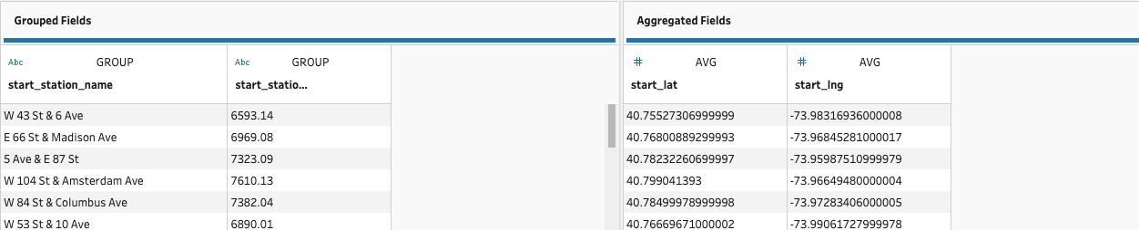
GROUPED AGGREGATION Using a grouped aggregation to make unique rows
Grouping
Columns
Columns to
Aggregate

Slide 33
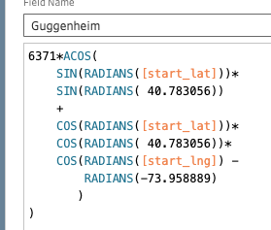
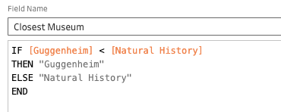
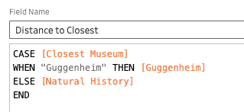
MUTATES Three examples of mutates
Reusing a formula
IF expression
CASE expression

Slide 34
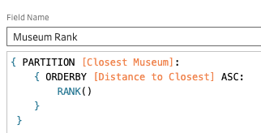
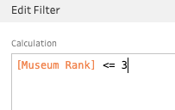
Group Rank + FILTER Using PARTITION + ORDER BY + FILTER to find the best stations
Grouped Rank
Filter

Slide 35
Exercise 3 Low code solution
Instructions
Open Tableau Prep
Complete the following in a new node.
Use grouped aggregation to get one station per row
Copy + Paste + Edit great circle distance node to compute the distance to each museum.
Use an IF expression to determine the closest museum.
Use a CASE statement to get the distance to the closest museum.
Use PARTITION and ORDERBY to rank the station distance for each museum.
Use a FILTER to get the closest three museums.

Slide 36
Translate to Code
Implementing code from low code solutions

Slide 37
Translate to Code From Tableau Prep to dplyr
Data Management
Summaries
&
Visualization
Statistical Learning

Slide 38
Exercise 4 Re-implement in Python using polars
Instructions
Open Tableau Prep
Complete the following in a new node.
Use grouped aggregation to get one station per row
Copy + Paste + Edit great circle distance node to compute the distance to each museum.
Use an IF expression to determine the closest museum.
Use a CASE statement to get the distance to the closest museum.
Use PARTITION and ORDERBY to rank the station distance for each museum.
Use a FILTER to get the closest three museums.

Slide 39
Problem 2 Museum Bike Tour
Start
Task.
Find the City Bike station closest to each of the three museums.
Assume we rent/return a bike at the start/end of each leg.
Stop 1
End

Slide 40
Appendix
A more detailed look at the content

Slide 41
Technology Agnostic Activities
Two web applications we use to introduce content in DSCI 210

Slide 42
Exercise 1 Purchasing Snowshoes
http://statsclass.org/dsci210/Dataverbs/

Slide 43
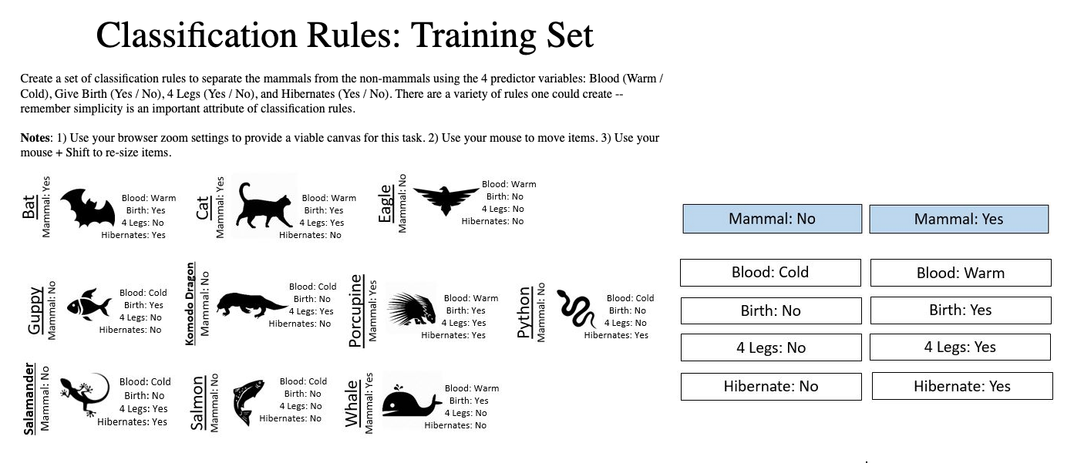


Exercise 3 Make your own rule (different than mine)
Train
Test
http://www.statsclass.org/dsci210/CART/train.html
http://www.statsclass.org/dsci210/CART/test.html

Slide 44
A Brief Tour of Tableau Prep
An overview of the basic features in Prep

Slide 45
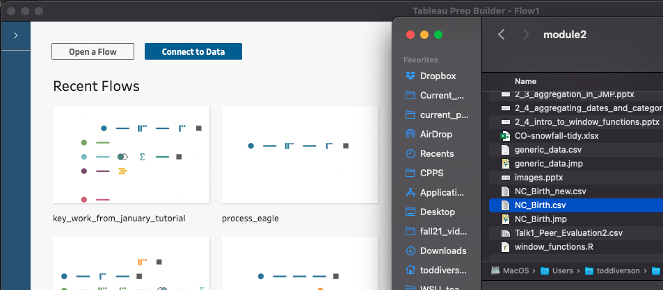
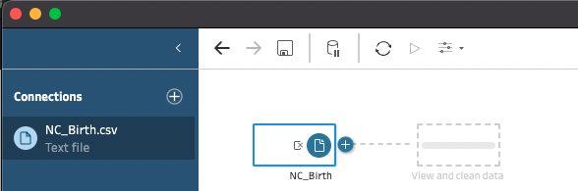
Opening csv file Drag-and-drop
Find the file in Explorer/Finder

Slide 46
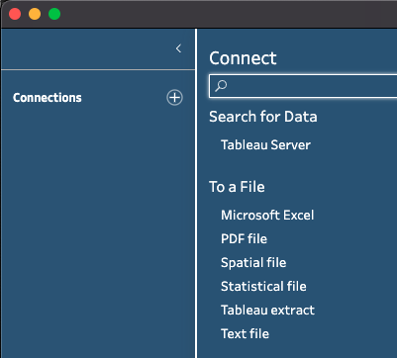
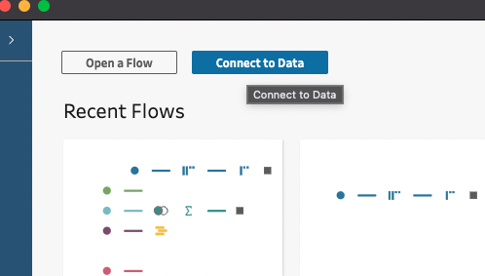
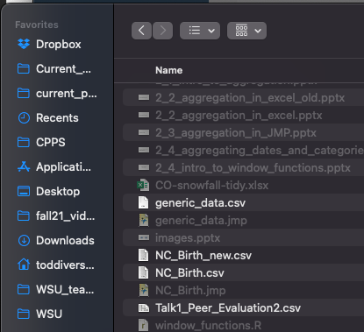
Opening csv file Connect to Data Button
Click
Click
Find the file in Explorer/Finder

Slide 47
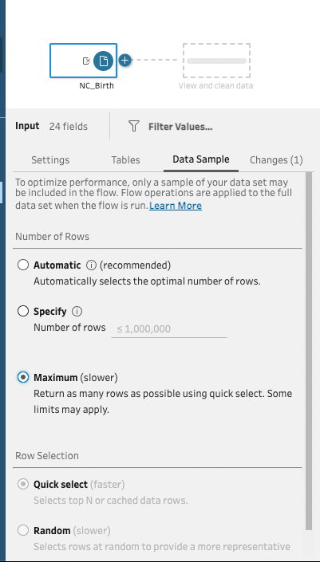
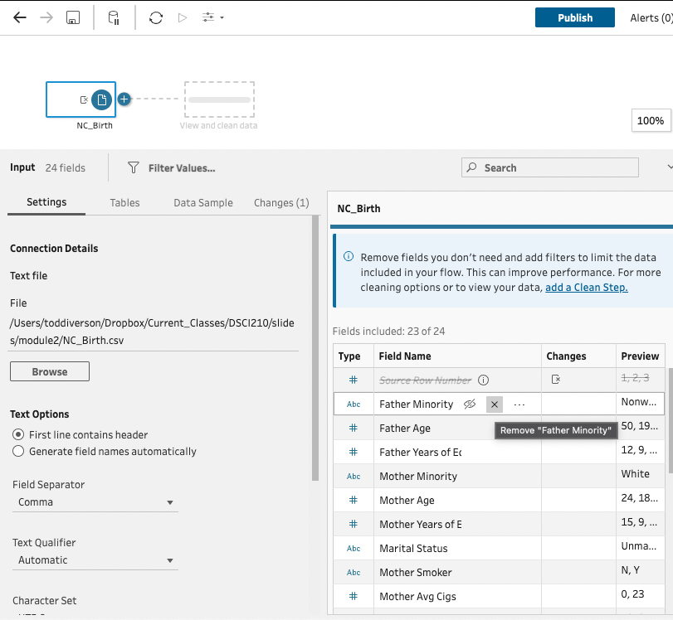
Initial Settings
Faster for large data sets
Remove a field
Best for small data sets
Change the data type
Hide a field

Slide 48
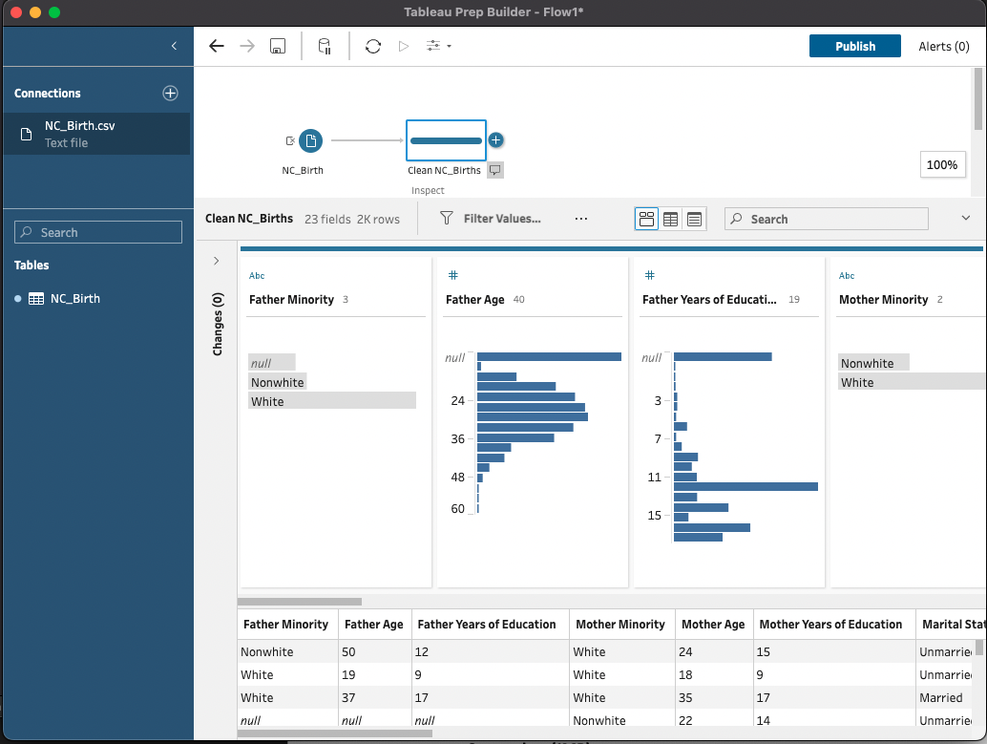
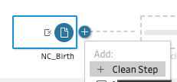
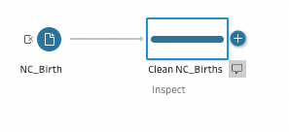
Inspecting with a clean step
Click
Click
Add Name
Add description

Slide 49
Inspecting with a clean step
Noun describing the content of the table
Verb(s) describing the data management actions applied

Slide 50
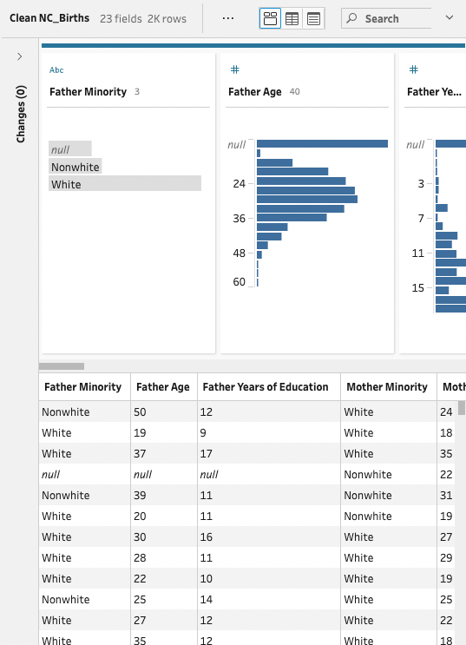
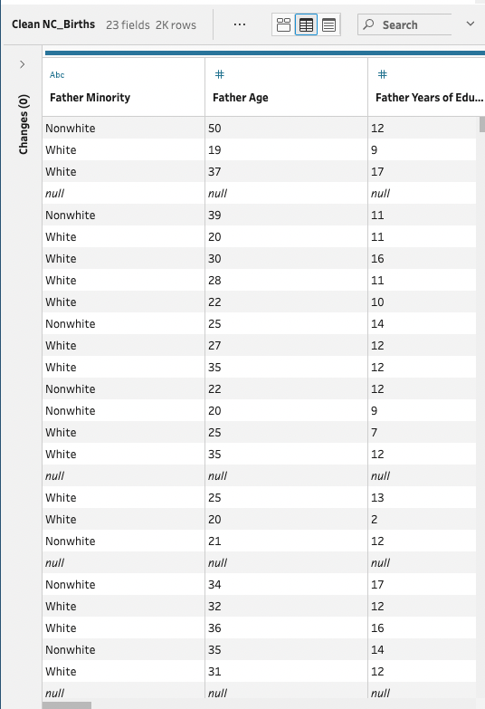
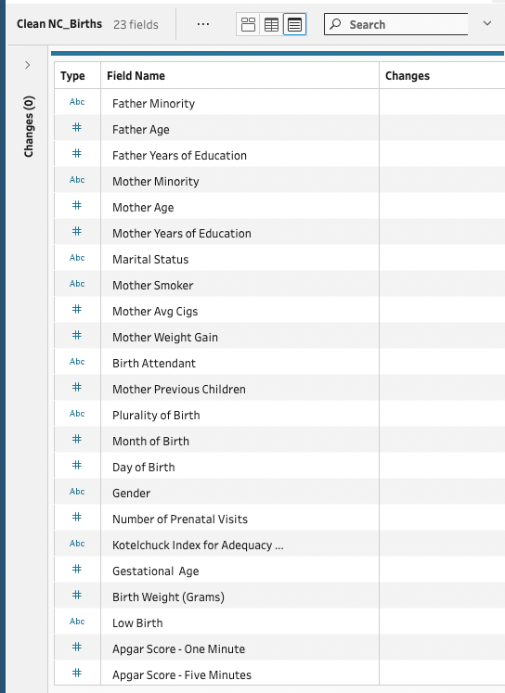
Three Views for Different Tasks
Table + Summaries
Just Table
Column List
Column Distribution
Column List
Column List
Data Table
Data Table

Slide 51
Aggregation with Tableau Prep
Using the Aggregate node to compute summaries

Slide 52
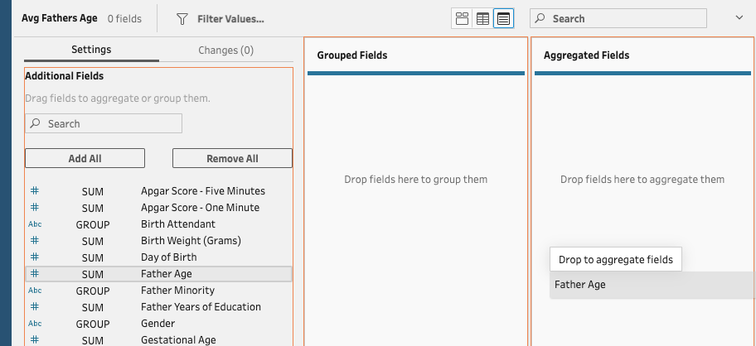
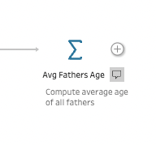
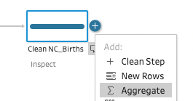
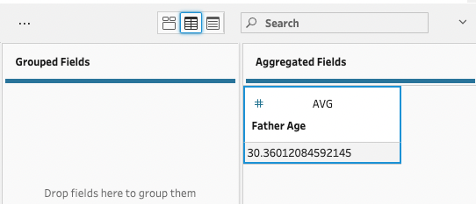
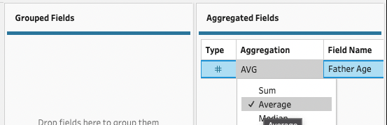
A simple aggregation
Numeric Field
Click
Add Name
Click
Add description

Slide 53
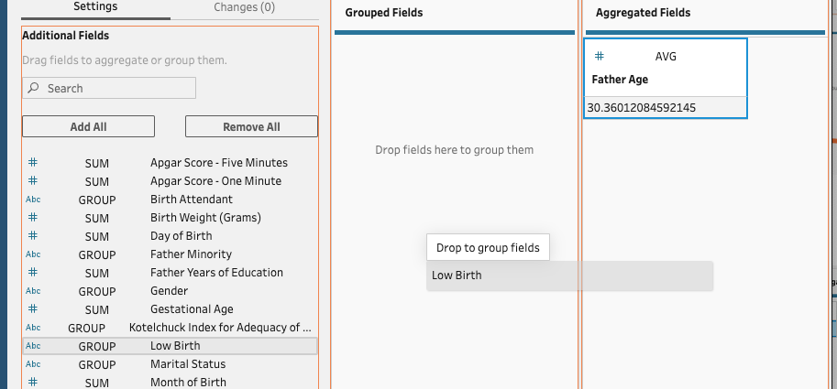
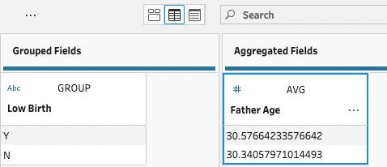
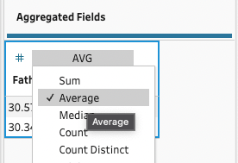
A grouped aggregation Numeric Field
Click
Add Name
Aggregation
Column here
Click
Add description
Pick
Summary
Change
Grouping
Column(s)
here

Slide 54
Branching Mutates in Tableau Prep
Examples of light coding of more complicated logic in Prep

Slide 55





IF Example NC_births.csv
Select Mother Smoker, Birth Weight,
& APGAR 5-minute
Mutate
Add a Clean Step
Name each step!

Slide 56





CASE Example NC_births.csv
Mutate
Add another Clean Step
“…based on population studies, Apgar scores of less than 5 at 5 minutes and 10 minutes clearly confer an increased relative risk of cerebral palsy, and the degree of abnormality correlates with the risk of cerebral palsy.” -- ACOG website
Name each step!

Slide 57
Ranking with Window Functions in Tableau Prep
Using PARTITION and ORDER BY to compute group rankings

Slide 58
What is a window?
Each row has an associated window (partition, order, & frame)
A row’s window is collection of related rows
Window functions compute a summary for each row over the corresponding window
The window function is a summary
Count
Mean
Median
Min
Max
Standard deviation
Rank

Slide 59



Grouped Aggregation
Window Functions
Summary functions collapse each group to a single row containing one or more summary statistics.
Summary functions compute the summary across each row’s window, with the result added to the original row.

Slide 60
Window functions amalgamate mutation and aggregation
Like MUTATE, a window function creates a new column based on existing columns
with one value per row.
Like AGGREGATION, a window function can summarize across multiple rows

Slide 61


Components of Window Functions
Partition
Order
Frame
Summary
PARTITION BY
Group
ORDER BY
Data DESC
ROWS
1 PRECEDING
SUM(Data)
Summary method providing one value for each original row
Each row is in one-and-only-one partition
Rows are ordered
Each row has a frame of other “close” rows
In DSCI 325

Slide 62

default partition
User-defined partition
PARTITION BY
()
ORDER BY
()
PARTITION BY
Group
ORDER BY
()
default order
PARTITION BY
()
ORDER BY
Data ASC
PARTITION BY
Group
ORDER BY
Data ASC
ascending order
PARTITION BY
()
ORDER BY
Data DESC
PARTITION BY
Group
ORDER BY
Data DESC
descending order

Slide 63


Example – Rank numbers in Prep Rank of all rows ordered by Data ASC, both Overall and by Group
Steps.
Order by Data ASC
Compute RANK()
Overall
By Group
Steps.
Partition by Group
Order by Data ASC
Compute RANK()

Slide 64
Other Insights
Additional insights learned in 10+ years of DSCI 210

Slide 65
Group work works
Students work together on challenging tasks

Slide 66
Group work works How we structure a class session
Lecture/Demo
20 Minutes
Group Activity
80 Minutes
60 Minutes

Slide 67
Group work works
Advantages
Caveats
Include the whole data cycle
Messy data → Insight
Practice tackling harder tasks
Students need the practice
We have small classes
20-30 students
We have a perfect classroom
~5 students per round table
Shared screen

Slide 68
The 80% Rule
A data scientist spends 80% of their time managing data!

Slide 69
The 80% Rule Time spent on data management
Intro to Tidy Data
Aggregation
Data Verbs
Intro to Visualization
Classification and CART
Managing textual data
Managing data with R/tidyverse
Reshaping tables
Table joins
Intro to association rules

Slide 70
Basics of Managing Tabular Data
Basic
Advanced
Select columns
Filter rows
Transform columns
Aggregation
Simple
Grouped
Reshape tables
Stack similar columns
Unstack/Pivot columns
Set operations on similar tables
Union of rows
Joins
Inner join
Left/Right join
Outer join

Slide 71
The Payoff
Make sure you are working toward some insight

Slide 72
Outline for DSCI 210 Don’t forget the payoff!
Exercises work toward some insight
Summary/Viz/Model
Intro to Tidy Data
Aggregation
Data Verbs
Intro to Visualization
Classification and CART
Managing textual data
Managing data with R/tidyverse
Reshaping tables
Table joins
Intro to association rules
Analytic tools ASAP!

